Slide 1
Amazon Sales Report Analysis
Analyzing Sales Data and Business Insights
By Rahul Kr Sharma
Aug 2024

Slide 2
Introduction
Sales Overviews
Product Analysis
Fulfillment Analysis
Customer Segmentation
Geographical Analysis
Business Insights & Recommendation
Conclusion

Slide 3
Introduction
Understanding sales performance and customer behavior is critical for driving business success.
Goal of study:
To extract actionable insights that can guide strategic decision-making, optimize the operation, and enhance overall customer experience.

Slide 4
Data Overview
Amazon Sales Report CSV
Data cleaning
Column Removes
Handle outliers
Capping outliers with Q1 and Q3
Missing values & duplicate values
Percentage of missing values
Columns with missing data
Number of duplicate records
Handling: Removal of duplicates and missing values

Slide 5
Sales Overviews:
Total Revenue
Daily sales
Weekly sales
Monthly sales
Quarterly sales

Slide 6
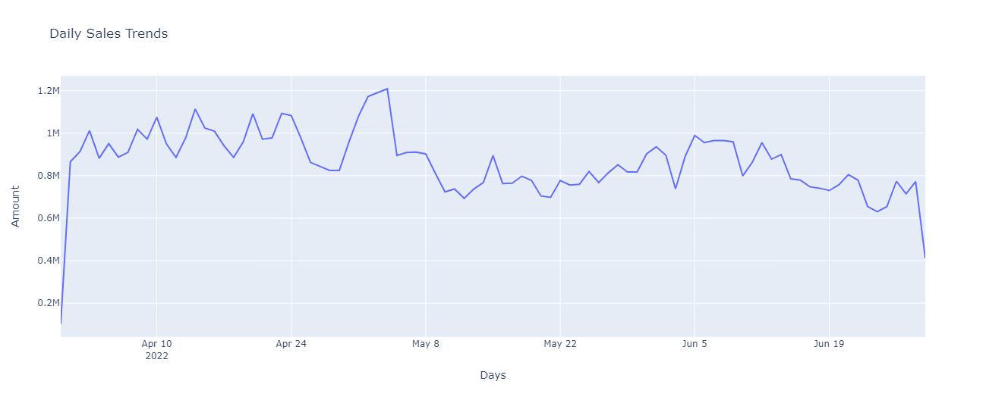
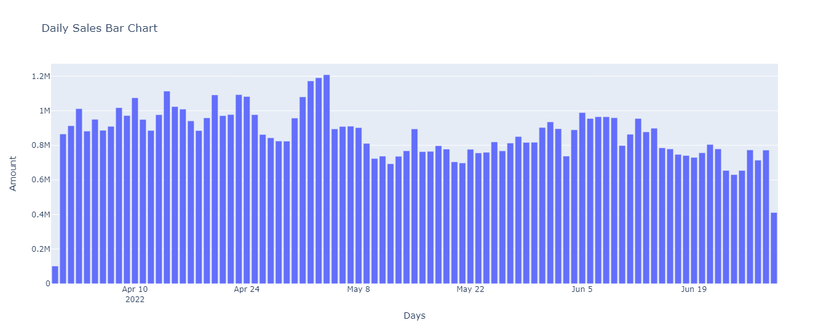
fig: Daily sales trends with different plots

Slide 7
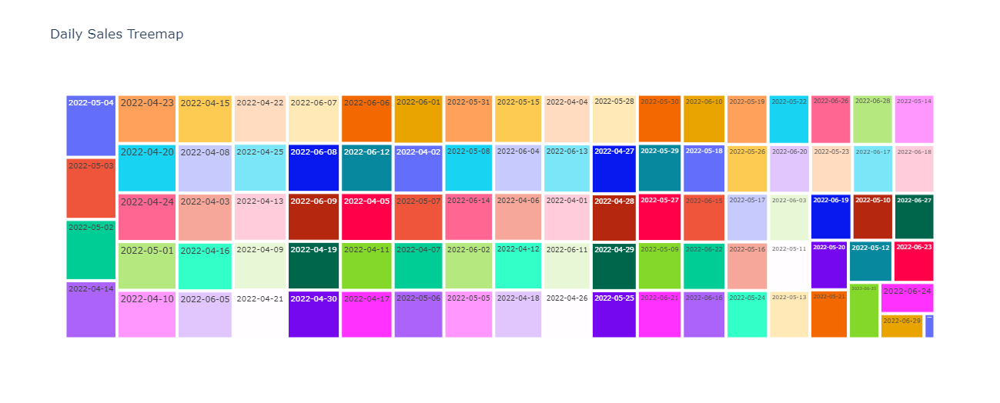
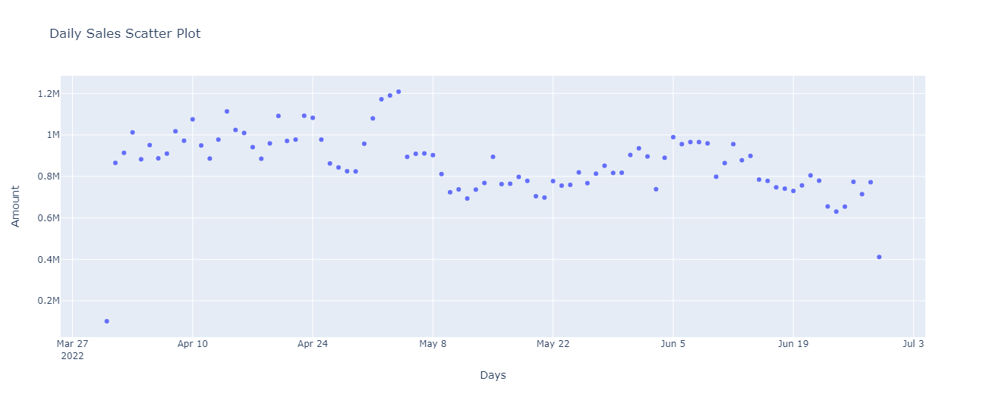
Notes:
What

Slide 8
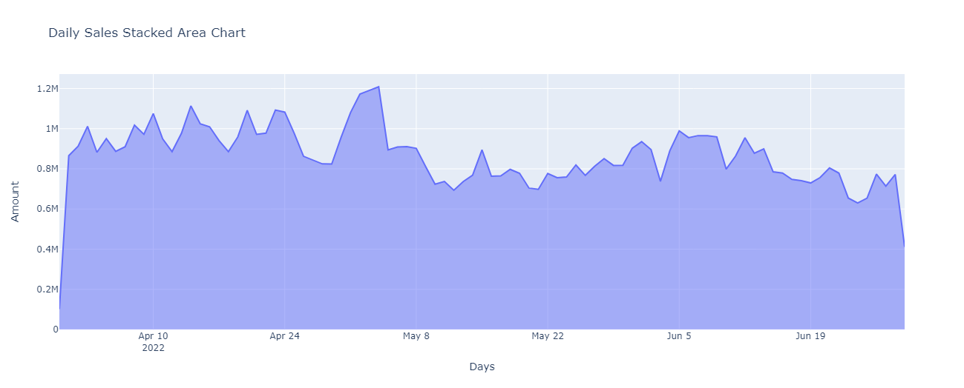

Slide 9
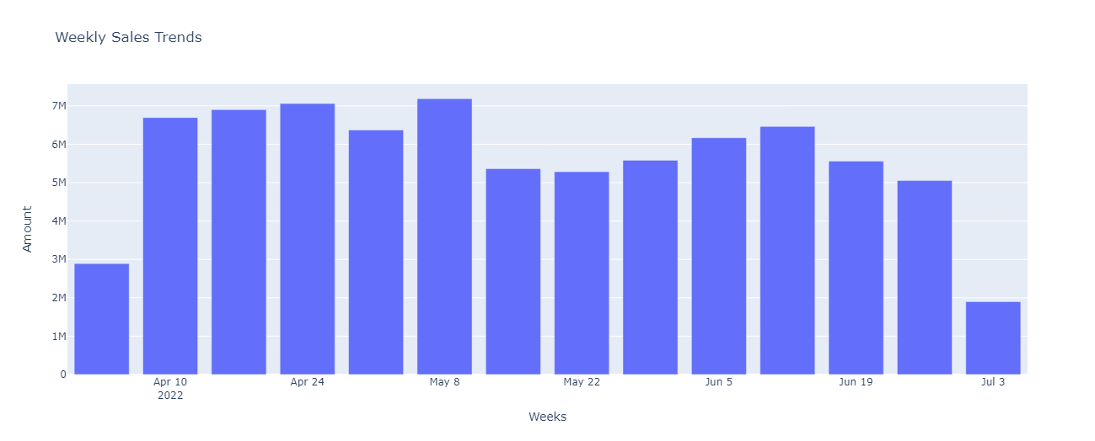
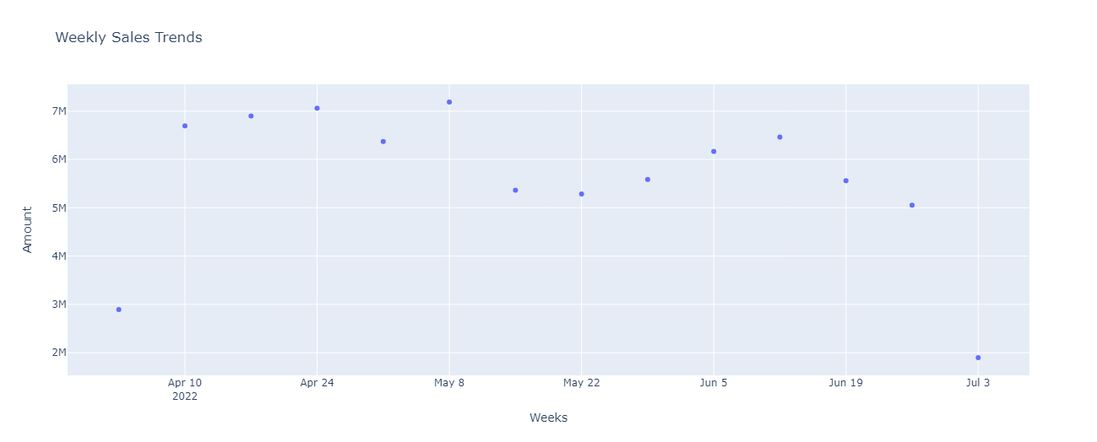
fig: Weekly sales trends with Bar and scatter plot

Slide 10
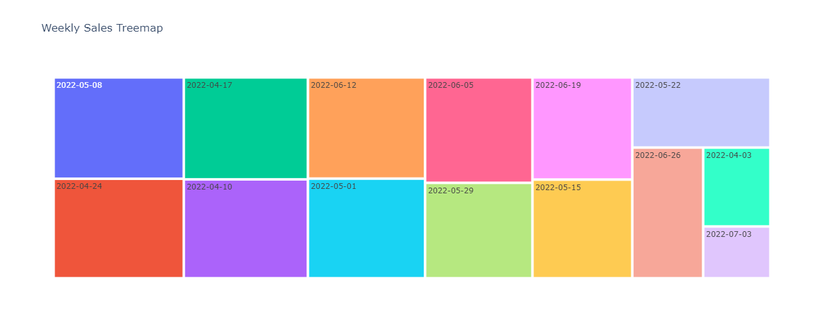
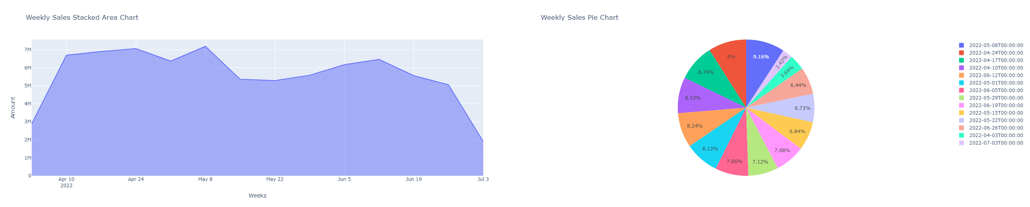
fig: Weekly sales trends with tree map, stack area chart, & pie chart

Slide 11
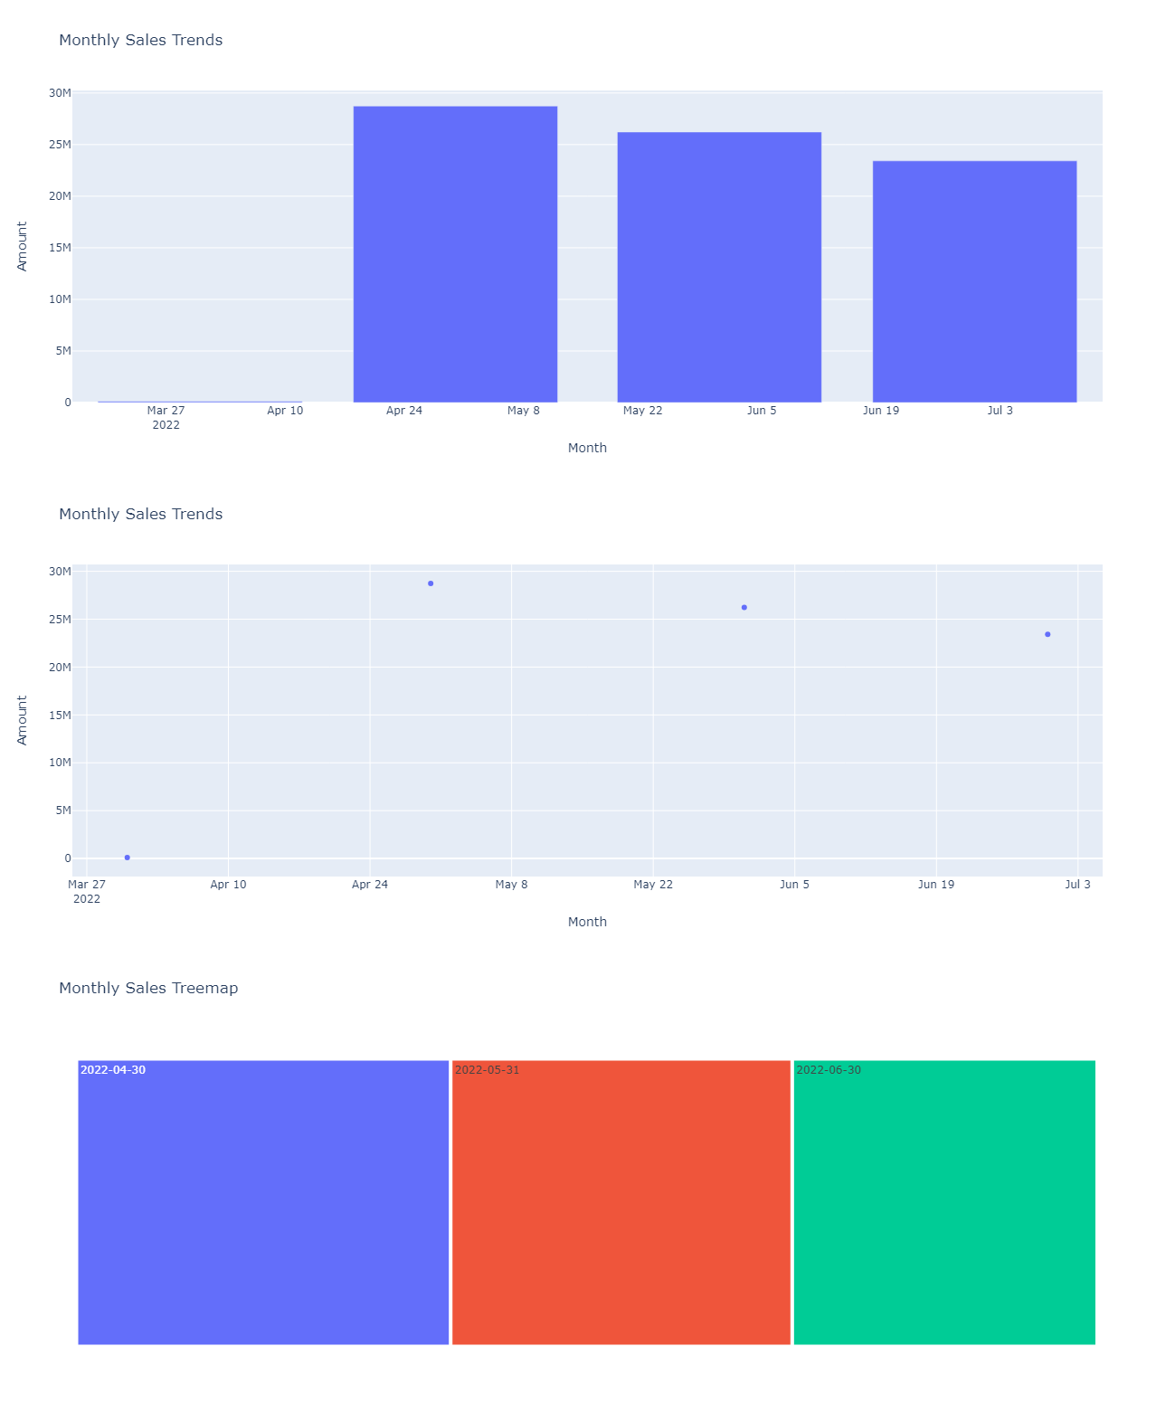
fig: Monthly trends with different plots

Slide 12
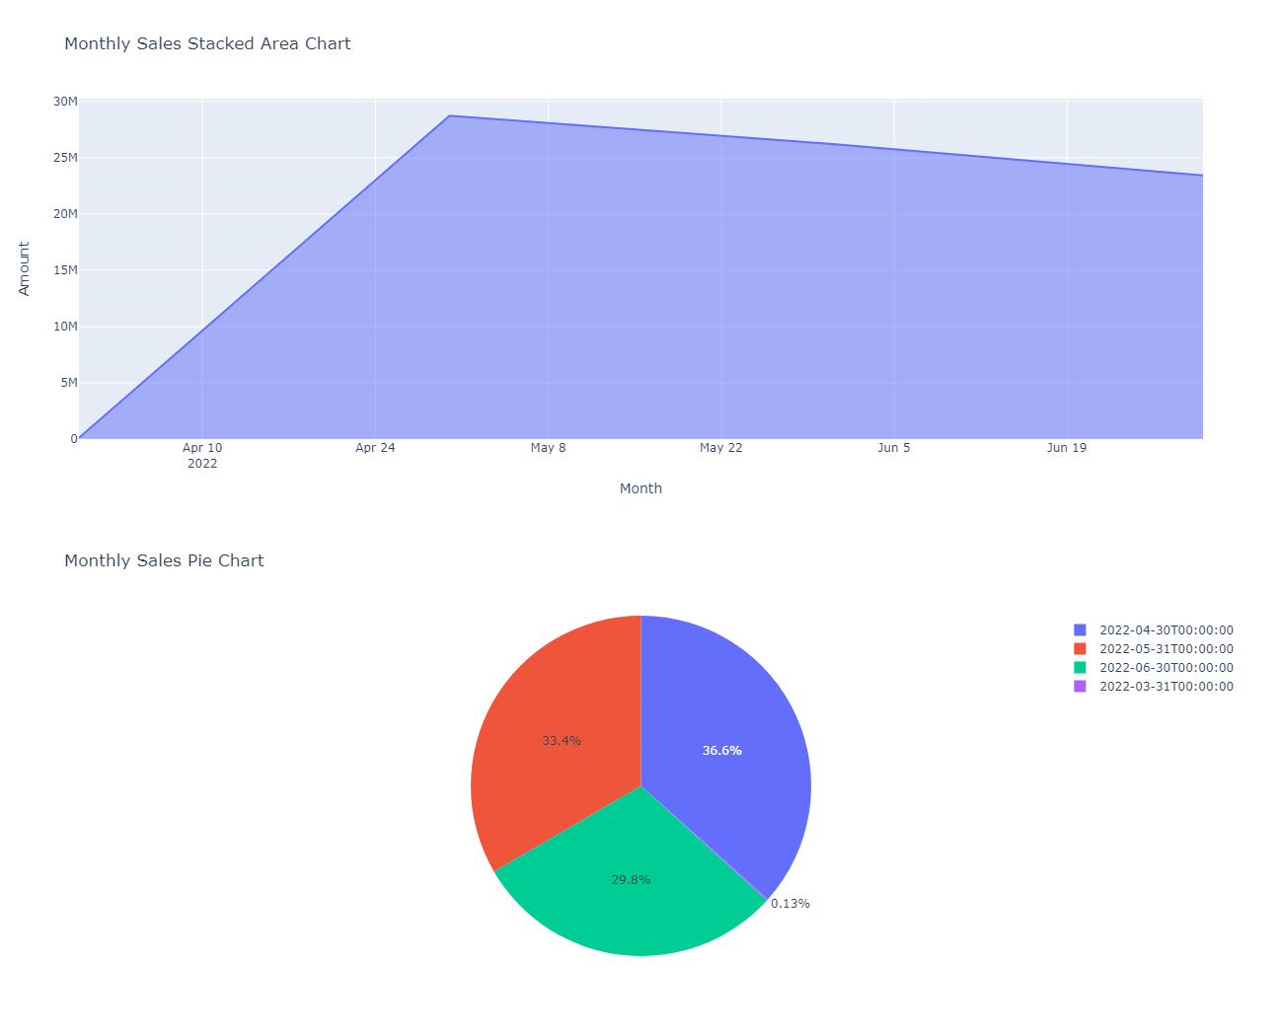
fig: Monthly trends with different plots

Slide 13
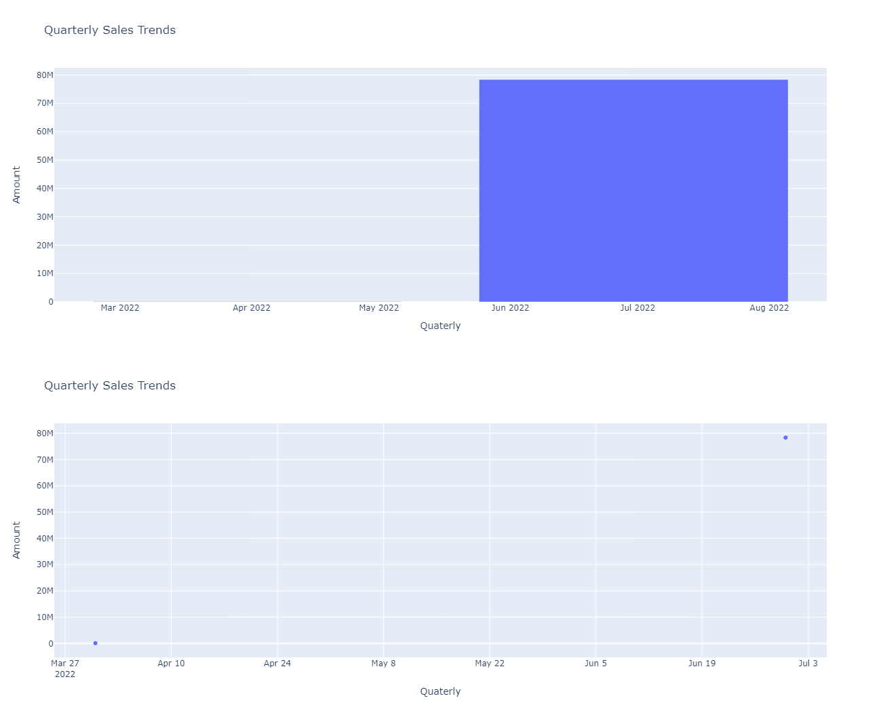
fig: Quarterly trends with different plots

Slide 14
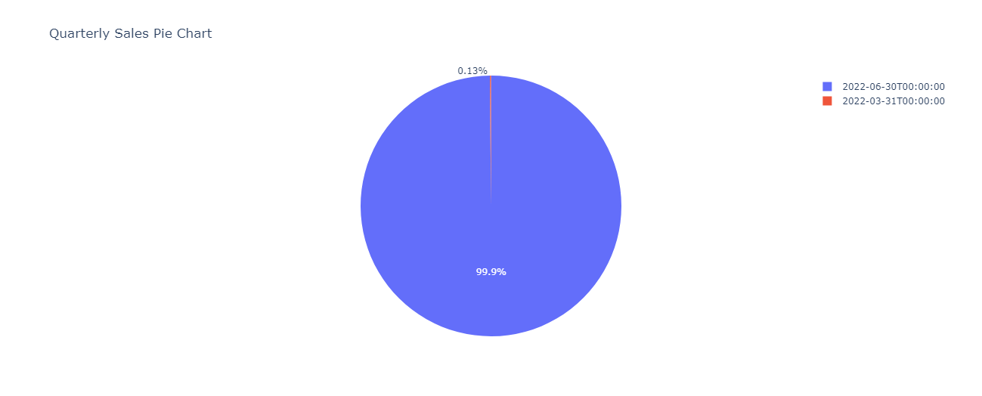
fig: Quarterly sales with pie chart

Slide 15
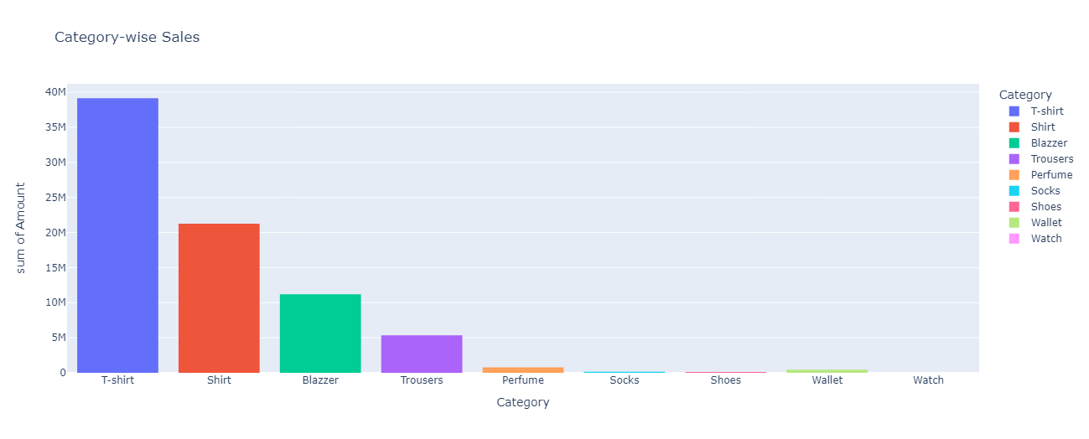
Product Analysis:

Slide 16
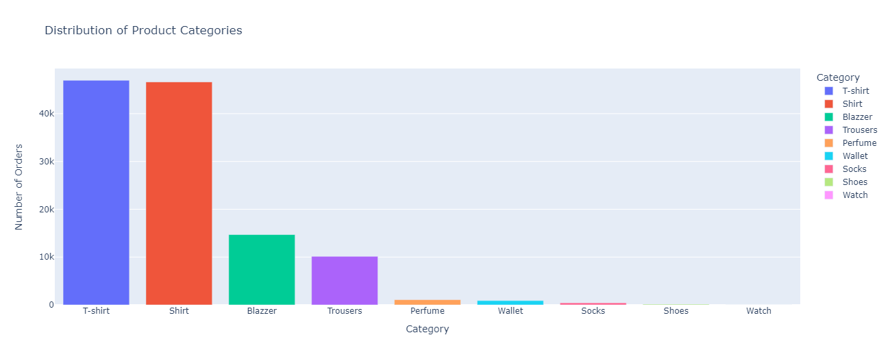

Slide 17
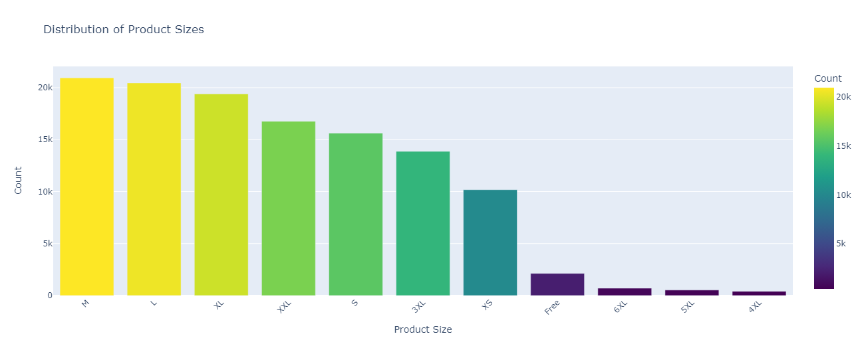

Slide 18
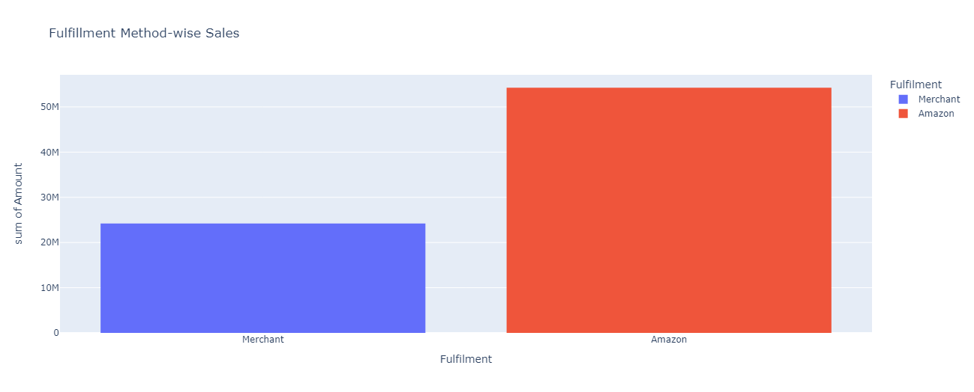
Fulfillment Analysis:

Slide 19
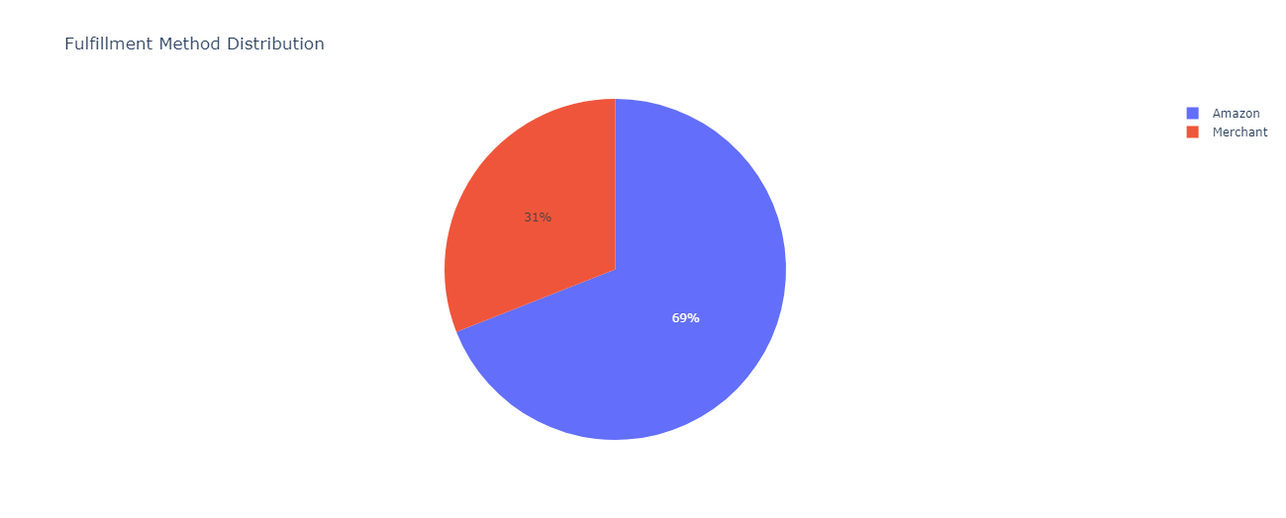

Slide 20
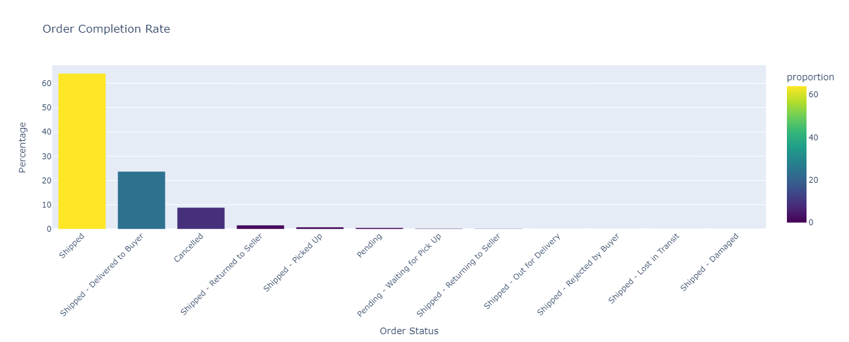

Slide 21
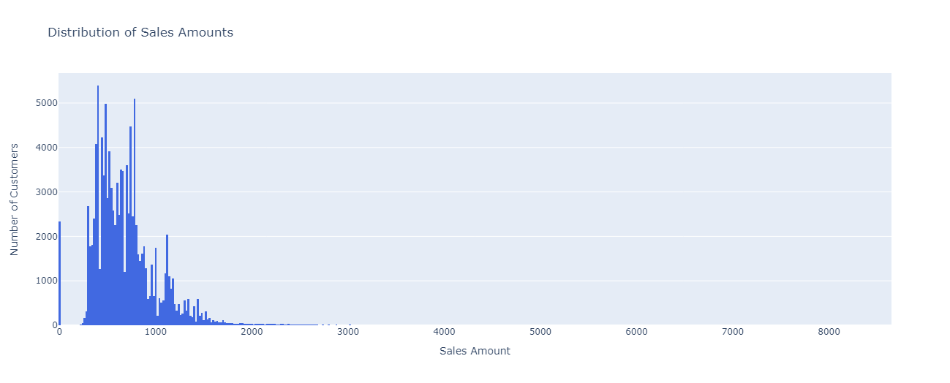
Customer Segmentation:

Slide 22
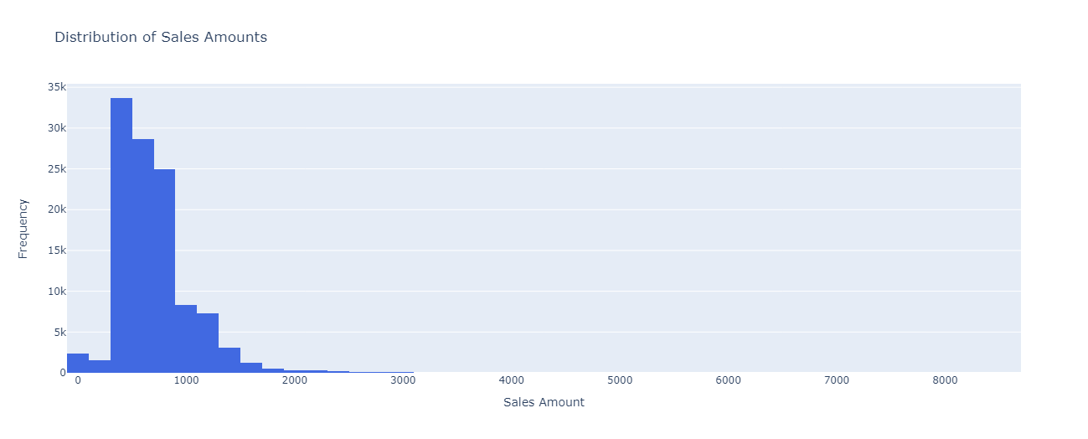

Slide 23
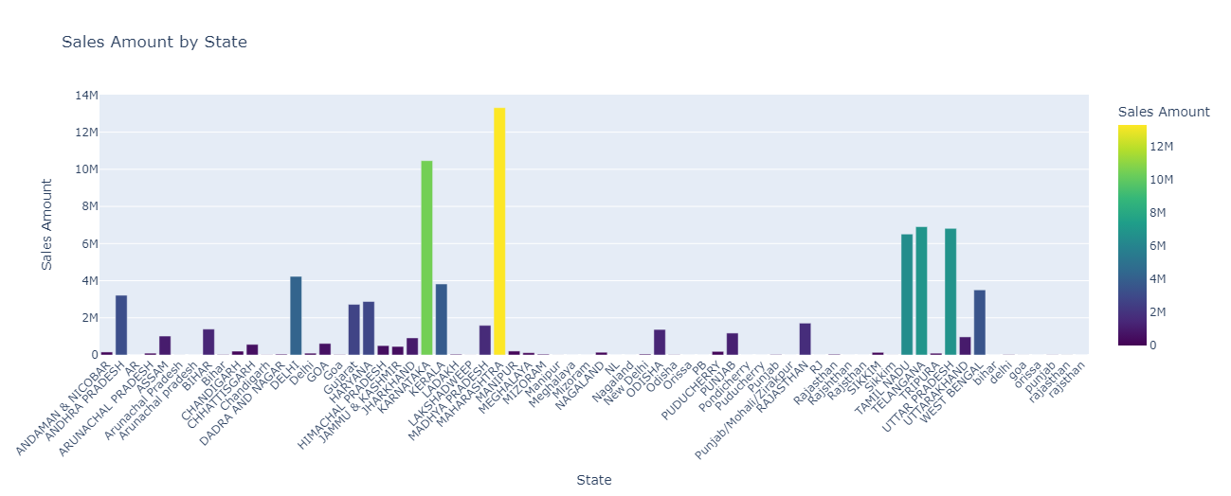

Slide 24

Business Insights & Recommendations
Product Strategy: Recommendation for inventory management, pricing, and marketing
Fulfillment optimization: Improving order processing efficiency & customer satisfaction

Slide 25
Conclusions:
The analysis of the Amazon sales report provides valuable insights that can be used to optimize operations.
To enhance customer experience & drive revenue.
By implementing the recommended strategies, the business can achieve greater efficiency & better customer needs.

